Slide 1
BK1_R
20A
CAFCI/GFCI
15A
Leviton
R57-T5325-0DW
BATH ROOM
Triple Switch
Leviton
R62-01755-0WS
15A/USBC
Leviton
R02-T5633-0BW
LIVING ROOM
Kidde
21029879
CO/SMOKE DETECTOR
15A
Leviton
R57-T5325-0DW
CEILING SOCKET
15A/USBC
Leviton
R02-T5633-0BW
LIVING ROOM
20A
Leviton
R82-16352-0W
SINK COUNTER
Bath Room
Fan and Light
FV-0510VSCL1
15A
R57-T5325-0DW
BATH ROOM
BK2_L
15A CAFCI
3-Way Switch
Leviton
R62-01453-02W
15A
Leviton
R57-T5325-0DW
TV
15A
Leviton
R57-T5325-0DW
FRIDGE
Range Hood
15A/USBC
Leviton
R02-T5633-0BW
LOFT
15A
Leviton
R57-T5325-0DW
INSIDE CLOSET
15A
Leviton
R57-T5325-0DW
OUTSIDE CLOSET
Living Room
Light
2-Way Switch
Leviton
R52-01451-02W
Living Room
Light
Double Switch
Leviton R62-05634-0WS
2-Way Switch
Leviton
R52-01451-02W
LEDme LED200
OUTDOOR LIGHT
3-Way Switch
Leviton
R62-01453-02W
Broan
Makeup Air
MD6TU
PANASONICERV
FV-04VE1
Loft Light
20A GFCI
R92-GFTR2-0KW
SINK COUNTER

Slide 2
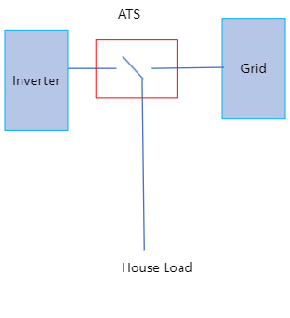
BK4_R
20A CAFCI
Solark
Sol-Ark 15K-2P-N
BK3_L
20A
125A ELECTRICAL PANEL
Square D
HOM1224L125PGCVP
50A
AC Works
ASINSS2PBX-D OUTDOOR
INLET SOCKET
20A GFCI
Leviton
R92-GFTR2-0KW
OUTDOOR SOCKET
20A GFCI
Leviton
R92-GFTR2-0KW
RIGHT COUNTER SOCKET
50A RV Surge Protector
First Defence
7 Panels
REC Solar
REC370AA
BK5 240V
50A
BK6_R
20A CAFCI/GFCI
BK7_R
20A
CAFCI/GFCI
BK8_L
20A CAFCI
BK9_L
20A
CAFCI/GFCI
BK 30A 240V
50A
Midwest Electric
U054P
OUTDOOR
OUTLET SOCKET
20A
Leviton
R82-16352-0W
WASHER/DRYER
Ariston
ANDRIS RS 8U 1.4KW
WATER HEATER
20A GFCI
Leviton
R92-GFTR2-0KW
LEFT COUNTER SOCKET1
20A GFCI
Leviton
R92-GFTR2-0KW
LEFT COUNTER SOCKET2
Empava
EMP-ID12B2
INDUCTION COOKTOP

